Slide 1
Chapter 7 - Fault Tolerance

Slide 2
Introduction
  a major difference between distributed systems and single machine systems is that with the former, partial failure is possible, i.e., when one component in a distributed system fails
  such a failure may affect some components while others will continue to function properly
  an important goal of distributed systems design is to construct a system that can automatically recover from partial failure
  it should tolerate faults and continue to operate to some extent

Slide 3
Objectives of the Chapter
  we discuss
    fault tolerance, and making distributed systems fault tolerant
    process resilience (techniques by which one or more processes can fail without seriously disturbing the rest of the system)
    reliable multicasting to keep processes synchronized (by which message transmission to a collection of processes is guaranteed to succeed)
    distributed commit protocols for ensuring atomicity in distributed systems
    failure recovery by saving the state of a distributed system (when and how)

Slide 4
7.1 Introduction to Fault Tolerance
  Basic Concepts
    fault tolerance is strongly related to dependable systems
    dependability covers the following
      availability
        refers to the probability that the system is operating correctly at any given time; defined in terms of an instant in time
      reliability
        a property that a system can run continuously without failure; defined in terms of a time interval
      safety
        refers to the situation that even when a system temporarily fails to operate correctly, nothing catastrophic happens
      maintainability
        how easily a failed system can be repaired

Slide 5
dependable systems are also required to provide a high degree of security
a system is said to fail when it cannot meet its promises; for instance failing to provide it users one or more of the services it promises
an error is a part of a system’s state the may lead to a failure; e.g., damaged packets in communication
the cause of an error is called a fault
building dependable systems closely relates to controlling faults
a distinction is made between preventing, removing, and forecasting faults
a fault tolerant system is a system that can provide its services even in the presence of faults

Slide 6
faults are classified into three
  transient
    occurs once and then disappears; if the operation is repeated, the fault goes away; e.g., a bird flying through a beam of a microwave transmitter may cause some lost bits
  intermittent
    it occurs, then vanishes on its own accord, then reappears, ...; e.g., a loose connection; difficult to diagnose; take your sick child to the nearest clinic, but the child does not show any sickness by the time you reach there
  permanent
    one that continues to exist until the faulty component is repaired; e.g, disk head crash, software bug

Slide 7
Failure Modes - 5 of them
  Crash failure: a server halts, but was working correctly until it stopped
  Omission failure: a server fails to respond to incoming requests
    Receive omission: a server fails to receive incoming messages; e.g., may be no thread is listening
    Send omission: a server fails to send messages
  Timing failure: a server's response lies outside the specified time interval; e.g., may be it is too fast over flooding the receiver or too slow
  Response failure: the server's response is incorrect
    Value failure: the value of the response is wrong; e.g., a search engine returning wrong Web pages as a result of a search
    State transition failure: the server deviates from the correct flow of control; e.g., taking default actions when it fails to understand the request

Slide 8
  Arbitrary failure (or Byzantine failure): a server may produce arbitrary responses at arbitrary times; most serious
Failure Masking by Redundancy
  to be fault tolerant, the system tries to hide the occurrence of failures from other processes - masking
  the key technique for masking faults is redundancy
  three kinds are possible
    information redundancy; add extra bits to allow recovery from garbled bits (error correction)
    time redundancy: an action is performed more than once if needed; e.g., redo an aborted transaction; useful for transient and intermittent faults
    physical redundancy: add (replicate) extra equipment (hardware) or processes (software)

Slide 9
7.2 Process Resilience
  how can fault tolerance be achieved in distributed systems?
  one method is protection against process failures by replicating processes into groups
  we discuss
    what are the general design issues of process groups
    what actually is a fault tolerant group
    how to reach agreement within a process group when one or more of its members cannot be trusted to give correct answers

Slide 10
Design Issues
  the key approach to tolerating a faulty process is to organize several identical processes into a group
  all members of a group receive a message hoping that if one process fails, another one will take over
  process groups may be dynamic
    new groups can be created and old groups can be destroyed
    a process can join or leave a group
    a process can be a member of several groups at the same time
  hence group management and membership mechanisms are required
  groups may be flat (all processes are equal) or hierarchical (a coordinator and several workers)

Slide 11
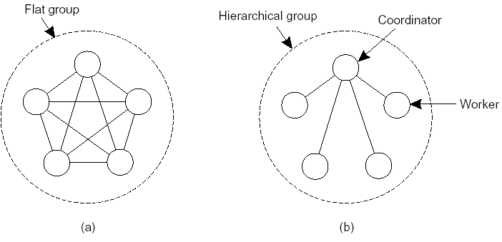
(a) communication in a flat group
(b) communication in a simple hierarchical group
the flat group has no single point of failure, but decision making is more complicated (voting may be required for decision making)
the hierarchical group has the opposite properties
group membership may be handled
  through a group server where all requests (joining, leaving, ...) are sent; it has a single point of failure
  in a distributed way (membership is multicasted)

Slide 12
Failure Masking and Replication
  how to replicate processes so that they can form groups?; there are two ways (as discussed in the previous chapter):
    primary-based protocols: for fault tolerance, primary-backup protocol is used; organize processes hierarchically and let the primary coordinate all writes; if the primary crashes, the backups hold an election
    replicated-write protocols: in the form of active replication or by means of quorum-based protocols; processes are organized as flat groups

Slide 13
  another important issue is how much replication is needed
  a system is said to be k fault tolerant if it can survive faults in k components and still meets its specifications
    if the processes fail silently, then having k+1 replicas is enough; if k of them fail, the remaining one can function
    if processes exhibit Byzantine failure, 2k+1 replicas are required; if the k processes generate the same reply (wrong), the k+1 will also produce the same answer (correct); but which of the two is correct is difficult to ascertain; unless we believe the majority

Slide 14
7.3 Reliable Client-Server Communication
  fault tolerance in distributed systems concentrates on faulty processes
  but communication failures also have to be considered
  a communication channel may exhibit failures in the form of
    crash
    omission
    timing
    arbitrary (duplicate messages as a result of buffering at nodes and the sender retransmitting)
  Point-to-Point Communication
    reliable transport protocols such as TCP can be used that mask most communication failures such as omissions (lost messages) using acknowledgements and retransmissions
    however, crash failures are often not masked; e.g., a broken TCP connection; in which case the system may probably setup a new connection automatically

Slide 15
RPC Semantics in the Presence of Failures
  the goal of RPC is to hide communication by making remote procedure calls look like local ones; may be difficult to mask remote calls when there are failures
  five different classes of failures can occur in RPC systems, each requiring a different solution
    the client is unable to locate the sever
    the client’s request to the server is lost
    the server receives the request and crashes
    the reply message from the server to the client is lost
    the client crashes after sending a request

Slide 16
1. the client is unable to locate the sever
  may be the client is unable to locate a suitable server or the server is down
  or an interface at the server has been changed making the client’s stub obsolete (it was not used for a long time) and the binder failing to match it with the server
  one solution: let the client raise an exception and have exception handlers; inserted by the programmer
  examples are exceptions in Java or signal handlers in C
  but
    not every language may provide exceptions or signals
    the major objective of having transparency is violated
2. the client’s request to the server is lost
  let the OS or the client stub start a timer when sending a request; if the timer expires before a reply or acknowledgement comes back, the message is retransmitted

Slide 17
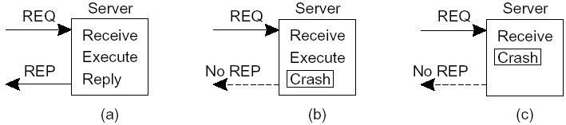
3. the server receives the request and crashes
  the failure can happen before or after execution
a server in client-server communication; (a) normal case, (b) crash after execution, (c) crash before execution
  in (b), let the system report failure back to the client (raise an exception)
  in (c) retransmit the request
  but the client’s OS doesn’t know which is which; only a timer has expired

Slide 18
three possible solutions
  the client tries the operation again after the server has restarted (or rebooted) or rebinds to a new server, called at least once semantics; keep on trying until a reply is received; it guarantees that the RPC has been carried out at least one time, but possibly more
  the client gives up after the first attempt and reports error, called at most once semantics; it guarantees that the RPC has been carried out at most one time, but possibly none at all
  no guaranty at all (0-N times)
none of the above is the right solution; what is required is exactly once semantics; but difficult to achieve

Slide 19
assume that
  a client would like to print some text
  the client receives an acknowledgement of receipt
the server can send a completion message and print or can print and then send a completion message (2 possibilities)
assume the server crashes and recovers, announces this; the client doesn’t know if its request will be carried out
what should the client do?; four possibilities
  never reissue a request (the text may not be printed)
  reissue a request (the text may be printed twice)
  assuming the server crashed before the request was delivered, it can decide to reissue a request only if it has not received an acknowledgement
  reissue a request only if it has received an acknowledgement
hence, with 2 strategies for the server and 4 for the client, there are a total of 8 possibilities, none of which is satisfactory

Slide 20
three possible events at the server: send the completion message (M), print the text (P), crash (C)
six different orderings of these events (the parentheses indicate an event that can no longer happen)
  a. if the server’s strategy is M → P
    M →P→C - a crash occurs after sending the completion message and printing the text
    M→C(→P)
    C(→M→P)
  b. if the server’s strategy is P → M
    P→M→C
    P→C(→M)
    C(→P→M)

Slide 21
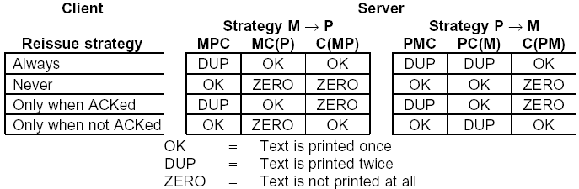
different combinations of client and server strategies in the presence of server crashes
none of all the combinations works; the client can never know whether the server crashes before or after printing

Slide 22
4. the reply message from the server to the client is lost
  the client sets a timer and resends
  there is a risk that the request is sent more than once; may be the server was slow
  however, if the operation is idempotent (an operation such as requesting a read that can be repeated without any harm), it does not create any problem; but what if the request is to transfer money from one account to another?
  let the client assign a sequence number to each request so that the server knows it is a duplicated one; but needs the server to maintain information on each client
  in addition, we can have a bit in the message header that is used to distinguish initial requests from retransmissions so as to take more care on retransmissions

Slide 23
5. the client crashes after sending a request
  in this case a computation may be done without a parent waiting for the result; such unwanted computations are called orphans
  orphans
    waste CPU cycles
    can lock valuable resources such as files
    can cause confusion if the client reboots and does the RPC again and the reply from the orphan comes back immediately afterward
  proposed solutions
    extermination: let the client stub maintain a log before sending an RPC message; after a reboot, inspect the log and kill the orphan; some problems
      the expense of writing a log for every RPC
      it may not work if the orphans themselves do RPC, creating grandorphans that are difficult to locate

Slide 24
reincarnation: divide time into sequentially numbered epochs; when a client reboots, it broadcasts a message to all machines declaring the start of a new epoch; when such a broadcast comes in, all remote computations on behalf of that client are killed
gentle reincarnation: when an epoch broadcast comes in, each machine checks to see if it has remote computations, and if so, tries to locate their owner; a computation is killed only if the owner cannot be found
expiration: each RPC is given a standard amount of time, T, to do the job; if it cannot finish, it must explicitly ask for another quantum; if after a crash the client waits a time T before rebooting, all orphans are killed; the problem is how to choose a reasonable value of T, since RPCs have differing needs

Slide 25
7.4 Reliable Group Communication
  how to reliably deliver messages to a process group (multicasting)
  Basic Reliable-Multicasting Schemes
    reliable multicasting means a message sent to a process group should be delivered to each member of that group
    transport protocols do not offer reliable communication to a collection of processes
    problems:
      what happens if a process joins a group during communication?
      what happens if a (sending) process crashes during communication?
      what if there are faulty processes?
    a weaker solution assuming that all receivers are known (and they are limited) and that none will fail is for the sending process to assign a sequence number to each message and to buffer all messages so that lost ones can be retransmitted

Slide 26
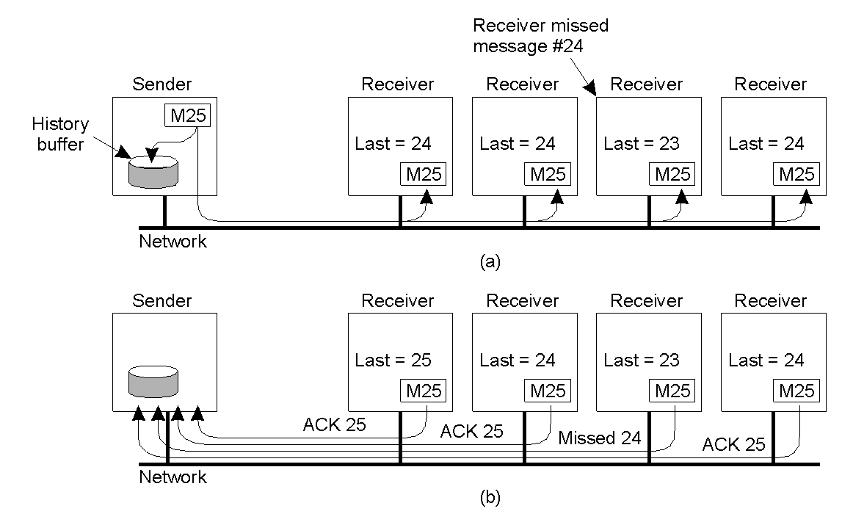
a simple solution to reliable multicasting when all receivers are known and are assumed not to fail; (a) message transmission, (b) reporting feedback

Slide 27
Scalability in Reliable Multicasting
  a reliable multicast scheme does not support large number of receivers; there will be feedback implosion
  two approaches for solving the problem
  1. Nonhierarchical Feedback Control
    reduce the number of feedback messages returned to the sender using feedback suppression
    the Scalable Reliable Multicasting Protocol (SRM) uses this principle
    only negative acks are returned as feedback and they are multicasted to all so that others that missed the message will refrain from sending a negative ack
    a receiver R that did not receive a message M schedules a feedback message with some random delay T; if another message for retransmitting M reaches R, R suppresses its transmission; else it transmits
    the sender will receive only a single negative ack and retransmits M to all

Slide 28
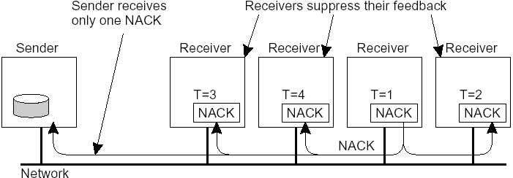
several receivers have scheduled a request for retransmission, but the first retransmission request leads to the suppression of others
feedback suppression scales well
disadvantages
  ensuring that only one feedback will reach the sender is difficult; there is a possibility of many receivers sending their feedback at the same time
  receivers that successfully receive a message waste their time processing negative acks and the duplicated message

Slide 29
  2. Hierarchical Feedback Control
    hierarchical solutions are better to achieve scalability for very large groups of receivers
    the group of receivers is partitioned into a number of subgroups, subsequently organized into a tree; the subgroup containing the sender forms the root of the tree
    within each subgroup, use any reliable multicasting scheme that works for small groups
    each subgroup appoints a local coordinator, responsible for handling retransmission requests in its subgroup; hence it has its history buffer
    dynamically constructing the tree is a problem
building reliable multicast schemes that can scale to a large number of receivers spread in a WAN is a difficult problem; more research is required

Slide 30
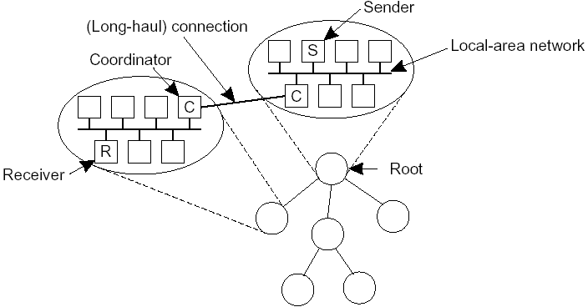
the essence of hierarchical reliable multicasting; each local coordinator forwards the message to its children and later handles retransmission requests

Slide 31
Atomic Multicast
  how to achieve reliable multicasting in the presence of process failures
  for example, in a replicated database, how to handle update operations when a replica crashes during update operations
  the atomic multicast problem: to guarantee that a message is delivered to either all processes or none at all and that messages are delivered in the same order to all processes

Slide 32
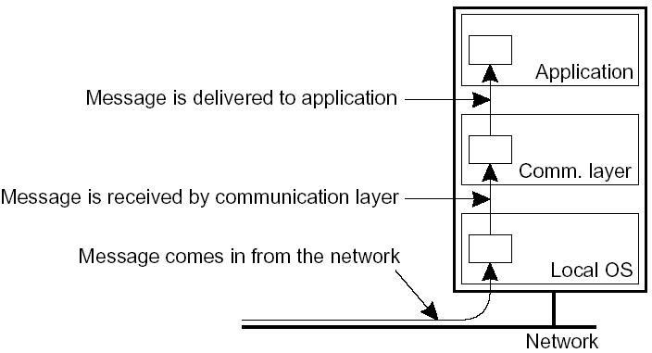
  Virtual Synchrony
    consider the following model in which the distributed system consists of a communication layer for sending and receiving messages; a received message is locally buffered in this layer until it is delivered to the application
the logical organization of a distributed system to distinguish between message receipt and message delivery

Slide 33
the whole idea of atomic multicasting is that a multicast message m is uniquely associated with a list of processes to which it should be delivered; this delivery list corresponds to a group view G, the view on the set of processes contained in the group, which the sender had at the time message m was multicast
a view change takes place by multicasting a message vc announcing the joining or leaving of a process, while the multicasting takes place
then there are two messages in transit: m and vc; we need a guarantee that m is either delivered to all processes in G before each of them receives vc, or m is not delivered at all
a reliable multicast guarantees that a message multicast to group G is delivered to each non-faulty process in G; if the sender crashes during the multicast, the message may either be delivered to all remaining processes or ignored by each of them; a reliable multicast with this property is said to be virtually synchronous

Slide 34
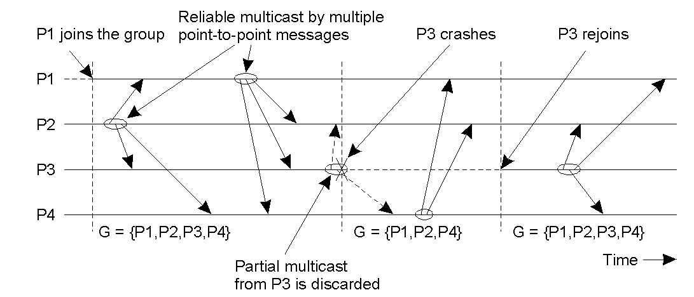
e.g., 4 processes; P3 crashes after successfully multicasting a message to P2 and P4 but not to P1; virtual synchrony guarantees that the message is not delivered at all; later P3 can join after its state has been brought up to date
hence, all multicasts take place between view changes; a view change acts as a barrier across which no multicast can pass; similar to synchronization variables used in distributed data stores

Slide 35
Message ordering
  there are four different orderings
  1. Unordered multicasts
    a reliable, unordered multicast is a virtual synchronous multicast in which no guarantees are given concerning the order in which received messages (by the communication layer) are delivered by different processes
Process P1 | Process P2 | Process P3
sends m1 | receives m1 | receives m2
sends m2 | receives m2 | receives m1
three communicating processes in the same group; the ordering of events per process is shown along the vertical axis

Slide 36
2. FIFO-ordered multicasts
  for reliable FIFO-ordered multicasts, the communication layer is forced to deliver incoming messages from the same process in the same order as they have been sent
  in the following example, m1 must always be delivered before m2; same to m3 and m4; but no constraint regarding messages originating from different processes
Process P1 | Process P2 | Process P3 | Process P4
sends m1 | receives m1 | receives m3 | sends m3
sends m2 | receives m3 | receives m1 | sends m4
 | receives m2 | receives m2
 | receives m4 | receives m4
four processes in the same group with two different senders, and a possible delivery order of messages under FIFO-ordered multicasting
3. Causally-ordered multicasts
  reliable causally-ordered multicast delivers messages so that potential causality between different messages is preserved

Slide 37
4. Totally-Ordered Multicasts
  besides the above three, a further constraint can be used; regardless of whether message delivery is unordered, FIFO ordered, or causally ordered, when messages are delivered, they are delivered in the same order to all group members
  i.e., totally-ordered multicast is used in combination with one of the three
  in the previous example of FIFO-ordered multicast, P2 and P3 must deliver messages m1, m2, m3, and m4 in the same order (still respecting FIFO ordering)

Slide 38
virtually synchronous reliable multicasting offering totally-ordered delivery of messages is called atomic multicasting
hence, there are a total of six forms of reliable multicasting (the three message orderings combined with atomicity)
Multicast | Basic Message Ordering | Total-ordered Delivery?
Reliable unordered multicast | None | No
FIFO multicast | FIFO-ordered delivery | No
Causal multicast | Causal-ordered delivery | No
Atomic multicast | None | Yes
FIFO atomic multicast | FIFO-ordered delivery | Yes
Causal atomic multicast | Causal-ordered delivery | Yes
six different versions of virtually synchronous reliable multicasting

Slide 39
7.5 Distributed Commit
  atomic multicasting is an example of the more generalized problem known as distributed commit
  in atomic multicasting, the operation is delivery of a message
  but the distributed commit problem involves having an(y) operation being performed by each member of a process group, or none at all
  there are three protocols: one-phase commit, two-phase commit, and three-phase commit
  One-Phase Commit Protocol
    a coordinator tells all other processes, called participants, whether or not to (locally) perform an operation
    drawback: if one of the participants cannot perform the operation, there is no way to tell the coordinator; for example due to violation of concurrency control constraints in distributed transactions

Slide 40
Two-Phase Commit Protocol (2PC)
  it has two phases: voting phase and decision phase, each involving two steps
  voting phase
    the coordinator sends a VOTE_REQUEST message to all participants
    each participant then sends a VOTE_COMMIT or VOTE_ABORT message depending on its local situation
  decision phase
    the coordinator collects all votes; if all vote to commit the transaction, it sends a GLOBAL_COMMIT message; if at least one participant sends VOTE_ABORT, it sends a GLOBAL_ABORT message
    each participant that voted for a commit waits for the final reaction of the coordinator and commits or aborts

Slide 41
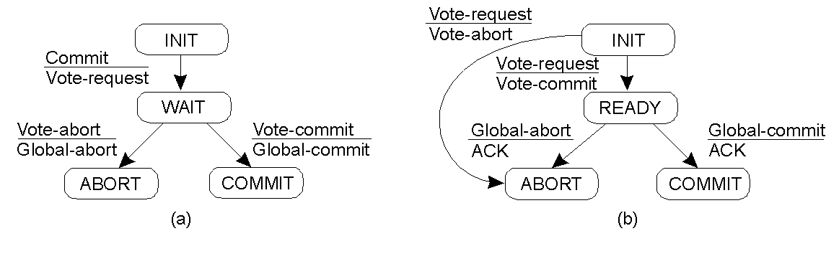
the finite state machine for the coordinator in 2PC
the finite state machine for a participant

Slide 42
State of Q | Action by P | Comments
COMMIT | Make transition to COMMIT | Coordinator sent GLOBAL_COMMIT before crashing
ABORT | Make transition to ABORT | Coordinator sent GLOBAL_ABORT before crashing
INIT | Make transition to ABORT | Coordinator sent VOTE_REQUEST before crashing
READY | Contact another participant | If all are in state READY, wait until the coordinator recovers
actions taken by a participant P when residing in state READY and having contacted another participant Q

Slide 43
Three-Phase Commit Protocol (3PC)
  the problem with 2PC is that, if the coordinator crashes, participants will need to block until the coordinator recovers (although such a probability is low and hence 2PC is widely used)
  3PC avoids blocking processes in the presence of crashes
  the states of the coordinator and each participant satisfy the following two conditions (necessary and sufficient conditions for a commit protocol to be nonblocking)
    there is no single state from which it is possible to make a transition directly to either COMMIT or an ABORT state
    there is no state in which it is not possible to make a final decision, and from which a transition to a COMMIT state can be made

Slide 44
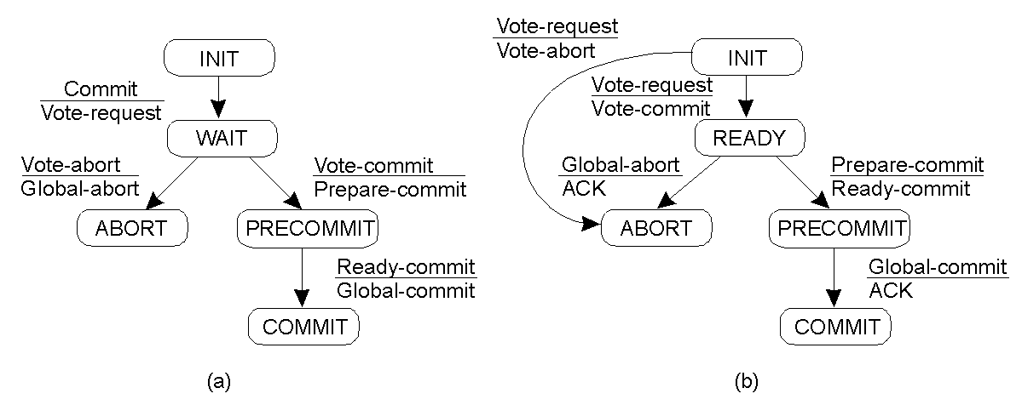
finite state machine for the coordinator in 3PC
finite state machine for a participant

Slide 45
7.6 Recovery
  fundamental to fault tolerance is recovery from an error
  error recovery means to replace an erroneous state with an error-free state
  two forms of error recovery: backward recovery and forward recovery
  Backward Recovery
    bring the system from its present erroneous state back into a previously correct state
    for this, the system’s state must be recorded from time to time; each time a state is recorded, a checkpoint is said to be made
    e.g., retransmitting lost or damaged packets in the implementation of reliable communication
    most widely used method, since it is a generally applicable method and can be integrated into the middleware layer of a distributed system

Slide 46
  disadvantages:
    checkpointing and restoring a process to its previous state are costly and performance bottlenecks
    no guarantee can be given that the error will not recur, which may take an application into a loop of recovery
    some actions may be irreversible; e.g., deleting a file, handing over cash to a customer
Forward Recovery
  bring the system from its present erroneous state to a correct new state from which it can continue to execute
  it has to be known in advance which errors may occur so as to correct those errors
  e.g., erasure correction (or simply error correction) where a lost or damaged packet is constructed from other successfully delivered packets

Slide 47
Stable Storage
  process states must be safely saved for recovery
  how to design a storage system that can survive most problems
  use a pair of disks
    each block on drive 2 is an exact copy of the corresponding block on drive 1
    when a block is updated, first the block on drive 1 is updated and verified, then the same block on drive 2 is done

Slide 48
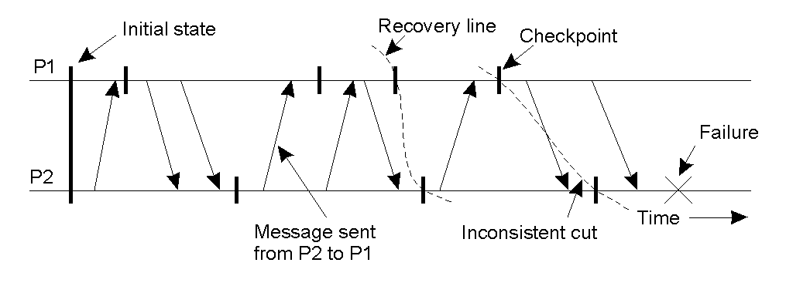
Check pointing
  to recover after a process or system failure requires that we construct a consistent global state (also called distributed snapshot) from the local states of each process (Chapter 5); i.e., if a process has recorded the receipt of a message, then there should be another process that has recorded the sending of that message
  it is best to recover from the most recent distributed snapshot, also referred to as a recovery line; it corresponds to the most recent consistent cut

Slide 49
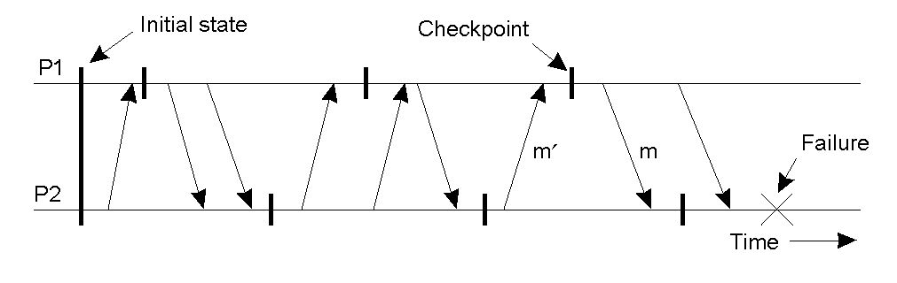
Independent Check pointing
  discovering a recovery line requires that each process should roll back to its most recently saved state; if the local states jointly do not form a distributed snapshot, further rolling back is necessary
  this process of cascaded rollback may lead to what is called the domino effect, i.e., it may not be possible to find a recovery line except the initial states of processes
  this happens if processes checkpoint independently
the domino effect

Slide 50
Coordinated Check pointing
  all processes synchronize to jointly write their state to local stable storage
  the saved state is automatically globally consistent, so that cascaded rollback leading to the domino effect is avoided
  the distributed snapshot algorithm (Chapter 5) can be used to coordinate check pointing
  or a two-phase blocking protocol can be used (centralised)
    a coordinator multicasts a CHECKPOINT_REQUEST message to all processes
    in receipt of such a message, each process takes a local snapshot and acknowledges to the coordinator
    the coordinator then multicasts a CHECKPOINT_DONE message
    Read about Message Logging (Pages 407-410)

Slide 51
Thank you!
?

